Slide 1
Matrix Transformation

Slide 2
Revision - Transformation

Slide 3
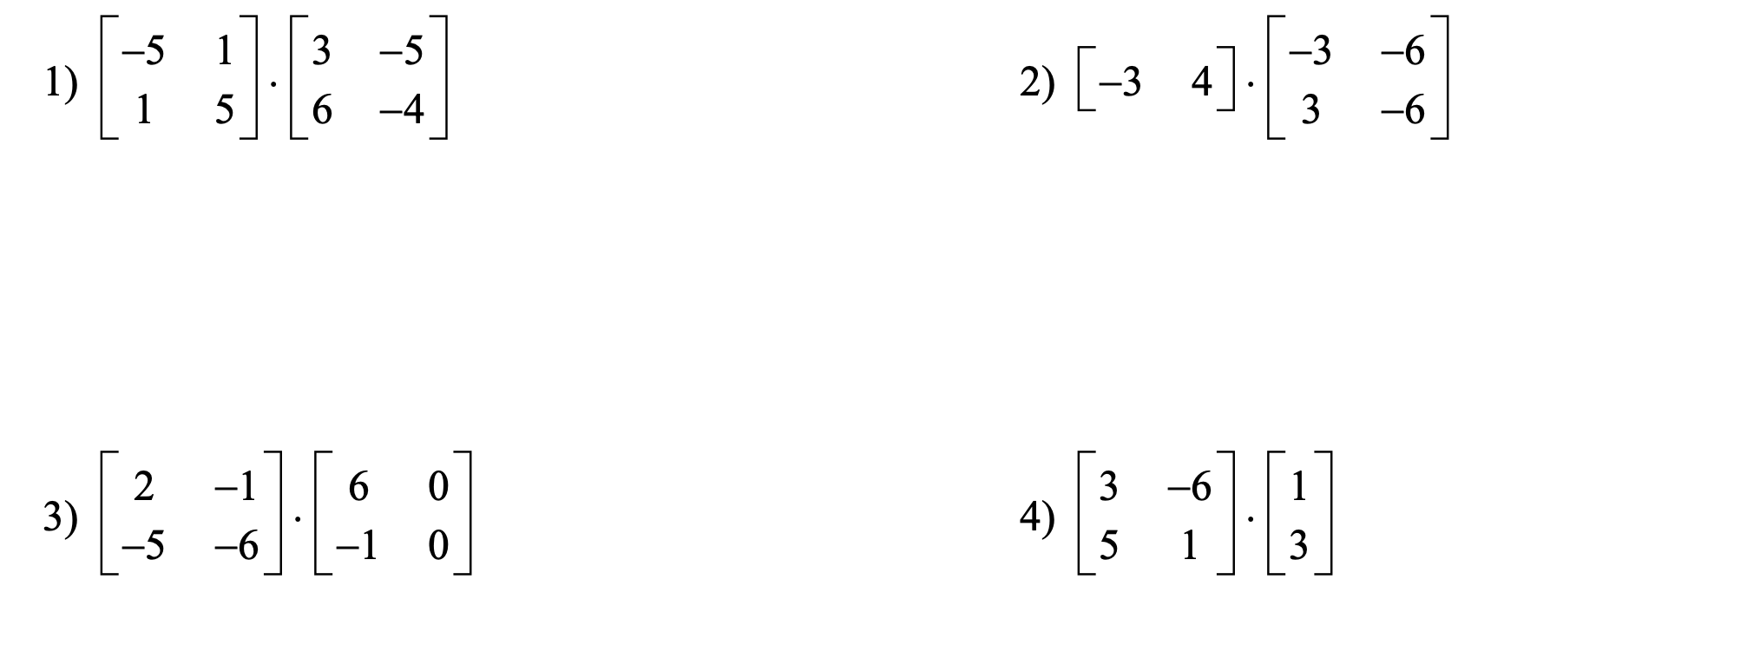
Revision – Matrix

Slide 22
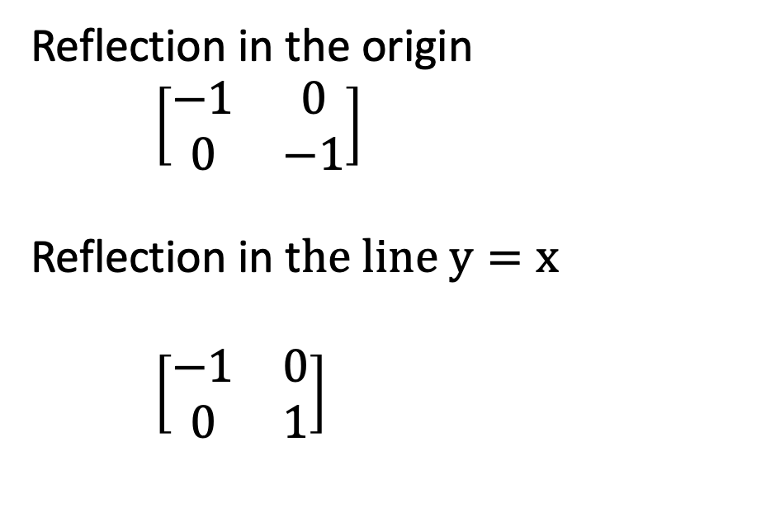
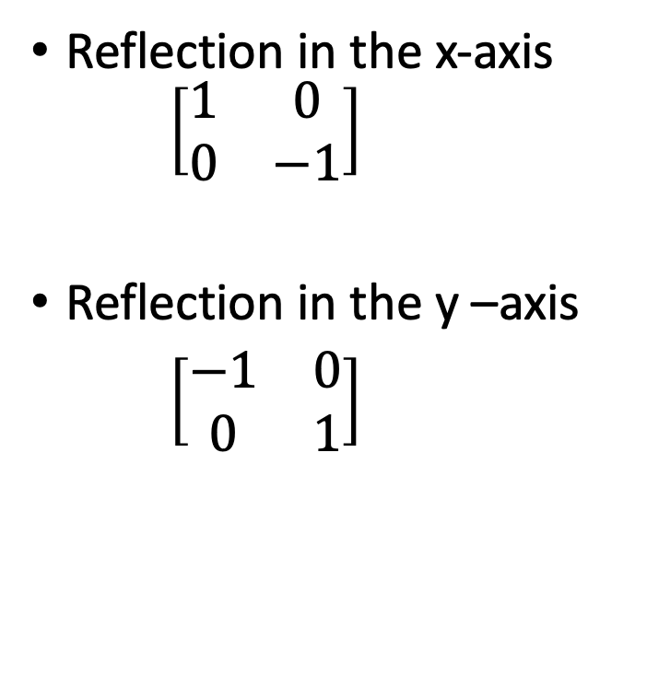
Summery
Reflection in the x-axis $\left[\begin{matrix}1 & 0 \\ 0 & −1\end{matrix}\right]$
Reflection in the y –axis
$\left[\begin{matrix}−1 & 0 \\ 0 & 1\end{matrix}\right]$
Reflection in the origin
$\left[\begin{matrix}−1 & 0 \\ 0 & −1\end{matrix}\right]$
Reflection in t$he line y=x$
$\left[\begin{matrix}−1 & 0 \\ 0 & 1\end{matrix}\right]$

Slide 23

Rotational Matrix
R= $\left[\begin{matrix}\cos{θ} & −\sin{θ} \\ \sin{θ} & \cos{θ}\end{matrix}\right]$
Where $θ$ is the rotation angle counter-clockwise

